Slide 2

Agenda
1
Completed Tasks
2
Development Pipeline
3
Upcoming Tasks
4
Previous & Current Roadblocks

Slide 3

1
Completed Tasks
‹#›

Slide 4
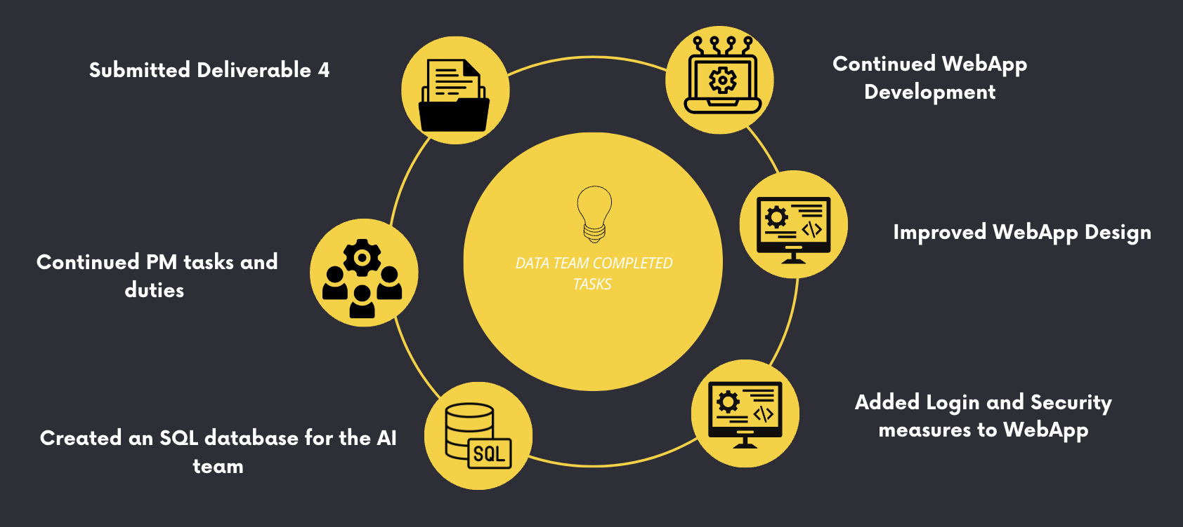
Completed Tasks - Data Team
Data Team Noorullah & Adam’s Completed Tasks
Team AI Tasks
Continued Development of WebApp
Increased and added more backend Functionality of WebApp
Completely redesigned and re-built the front end layout of WebApp
Used Tailwind CSS to add styling to WebApp.
Continued with PM Tasks and Duties
Created an SQL database for the AI team
Added Login and Security measures to WebApp
Notes:
Noorullah & Adam

Slide 5
Completed Tasks - AI Team
Completed Deliverable 4
Integrated Data
Reduced Resources
Technology Platform
Revised Deliverable 4 requirements from feedback
Created a user manual for creating resources and deploying models
Submitted Deliverable 4 on 17th October 2024
Integrated all 5 CSV files into Azure Blob Storage
Indexed and vectorized the data using cosine similarity formula
Able to make GPT-4o-mini to elaborate from user prompts
Only requires Open AI, Blob Storage Account and AI Search to operate
Will see reduced resource cost gradually
Identified existing Microsoft front-end UI for the model (MIT License) on GitHub.
Demo link: https://echo360.net.au/media/1138b7ec-d15b-48b3-a367-72a48b542970/public

Slide 6
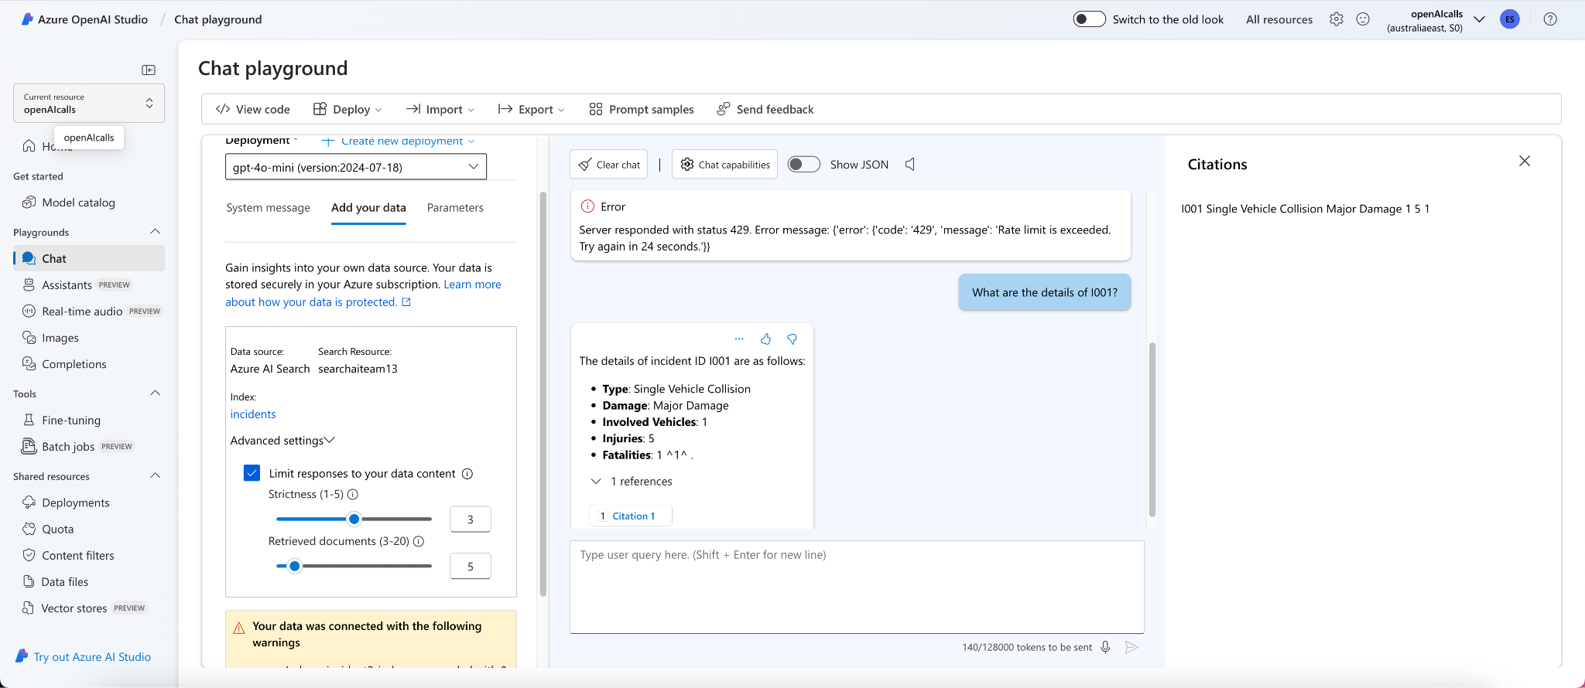
Screenshots of Returned Prompts (1)

Slide 7
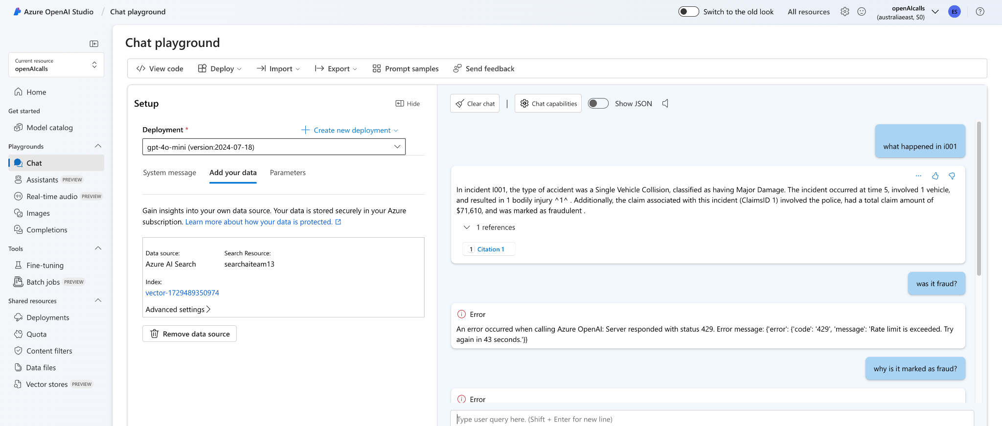
Screenshots of Returned Prompts (2)

Slide 8
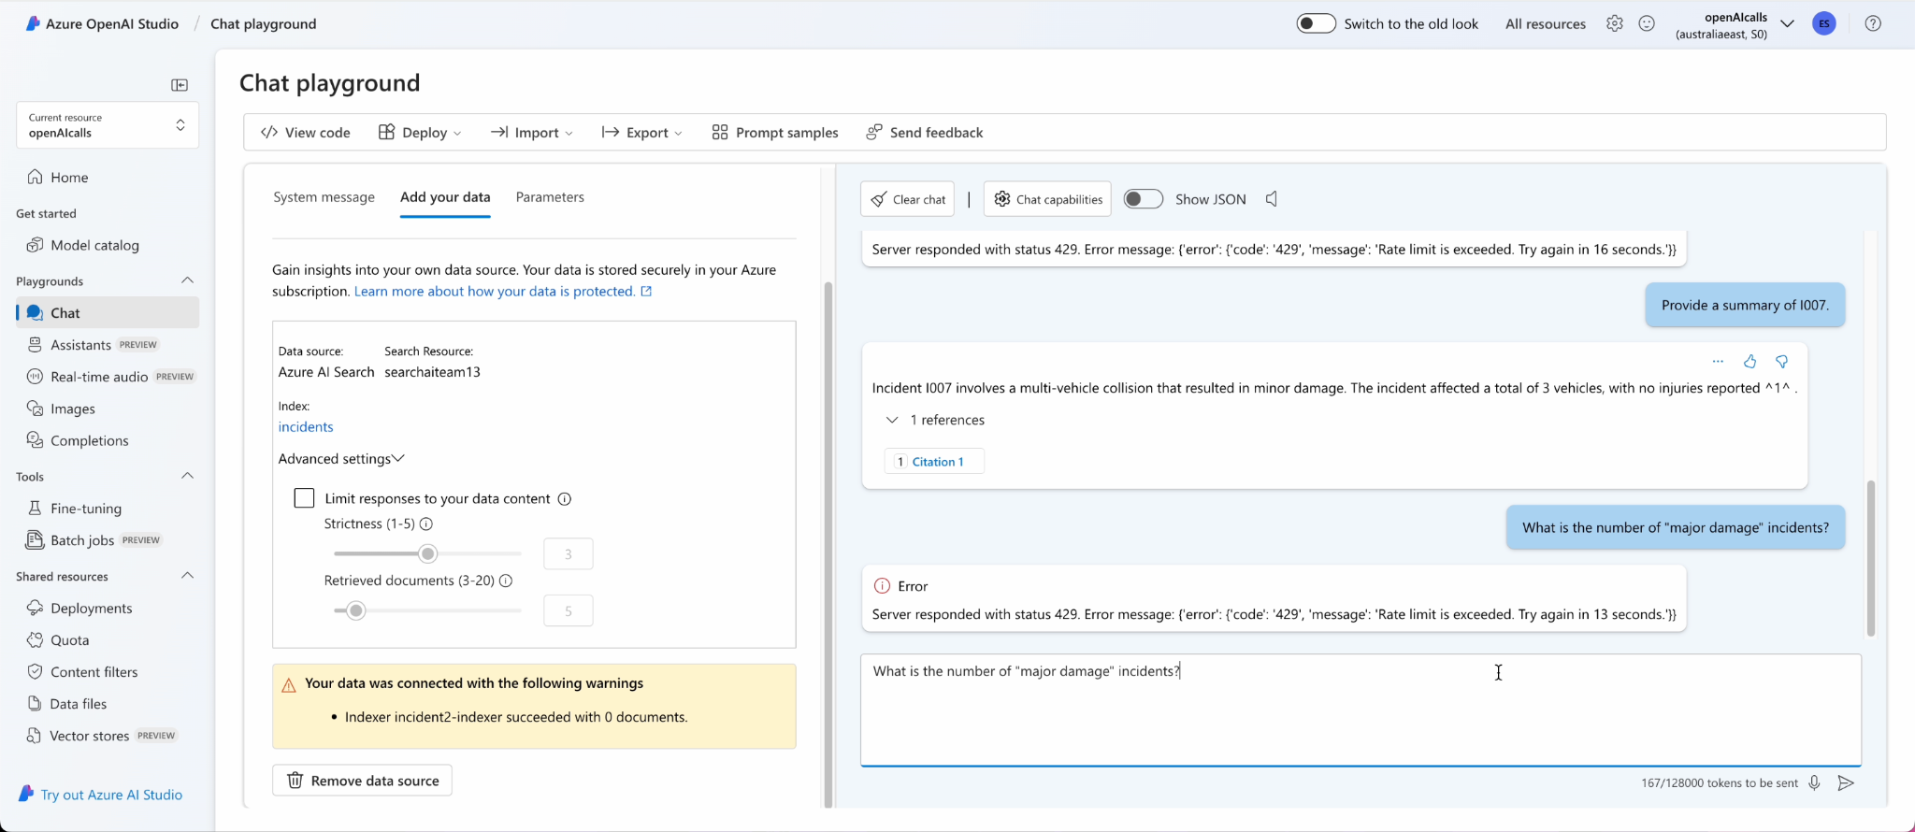
Screenshots of Returned Prompts (3)

Slide 9
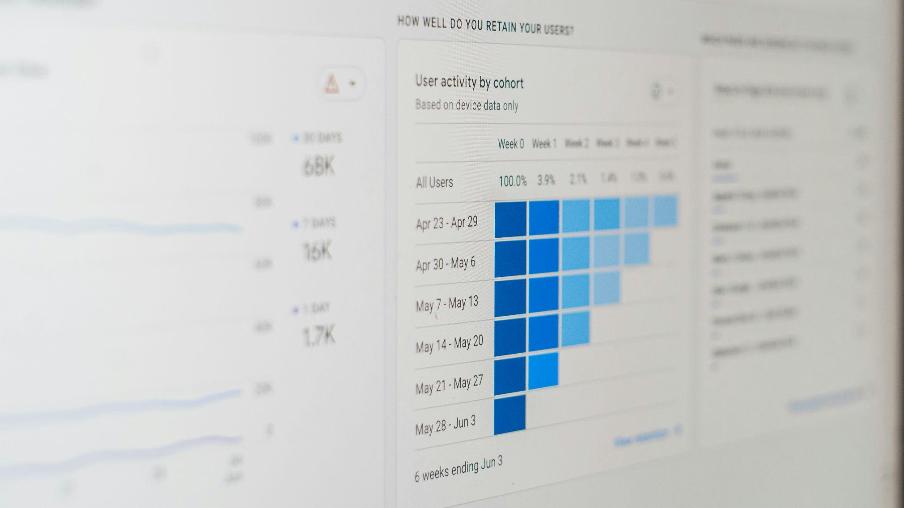
2
Development Pipeline
‹#›

Slide 10
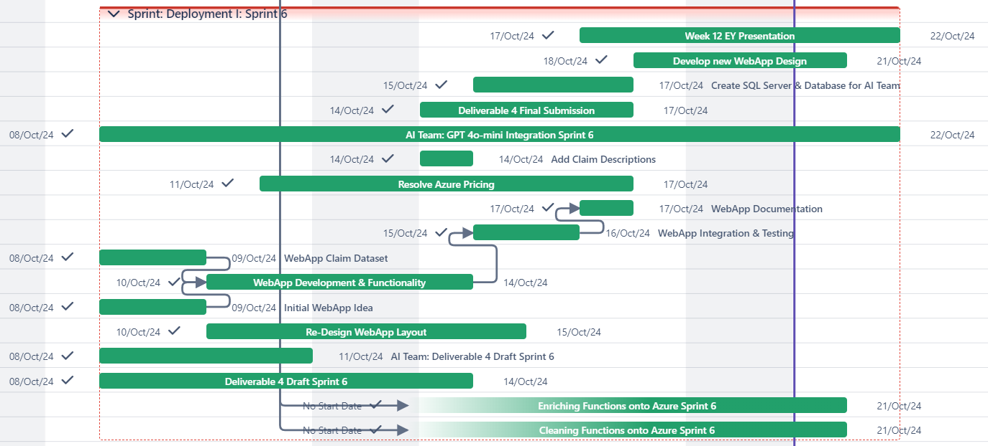
Development Pipeline - Gantt Chart
Notes:
Noor

Slide 11
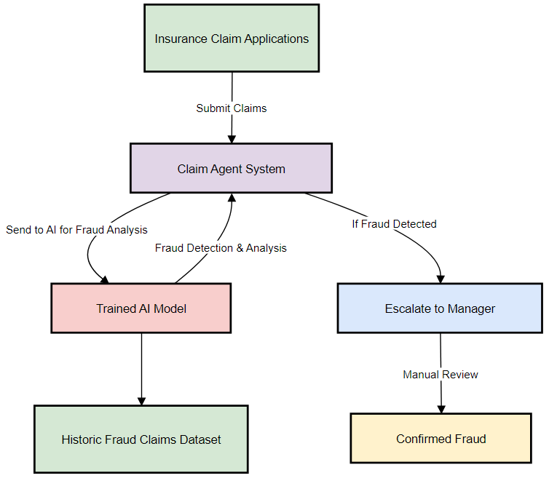
Final Solution Design
Notes:
Noor

Slide 12
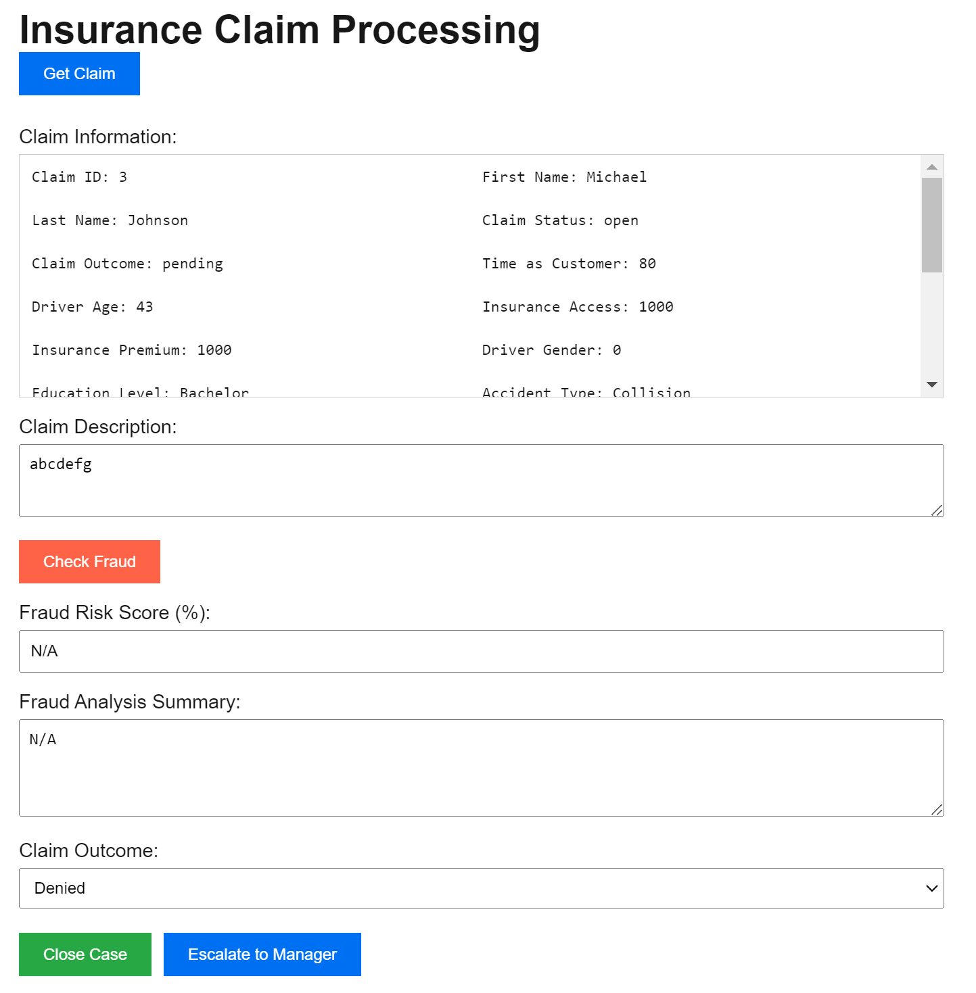
WebApp Design - Last Week
Notes:
Noor

Slide 13
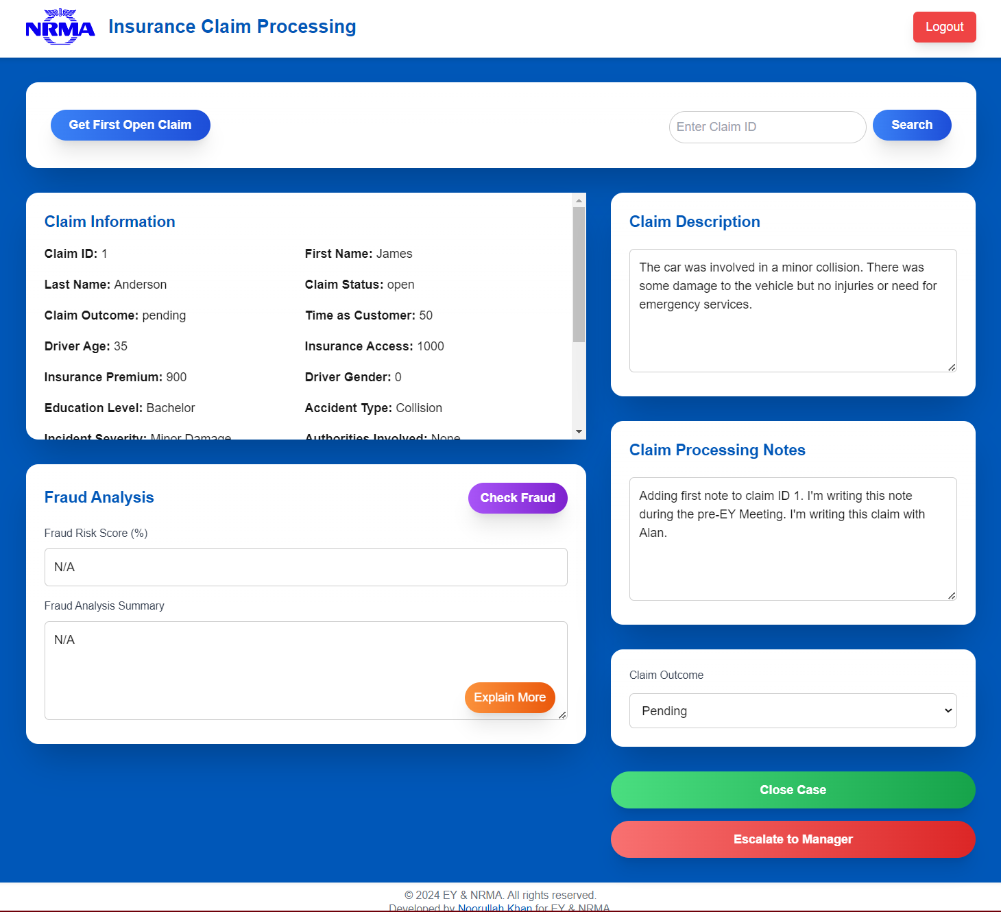
WebApp Design - Updated (Tailwind CSS)
Notes:
Noor

Slide 14


3
Upcoming Tasks
‹#›

Slide 15
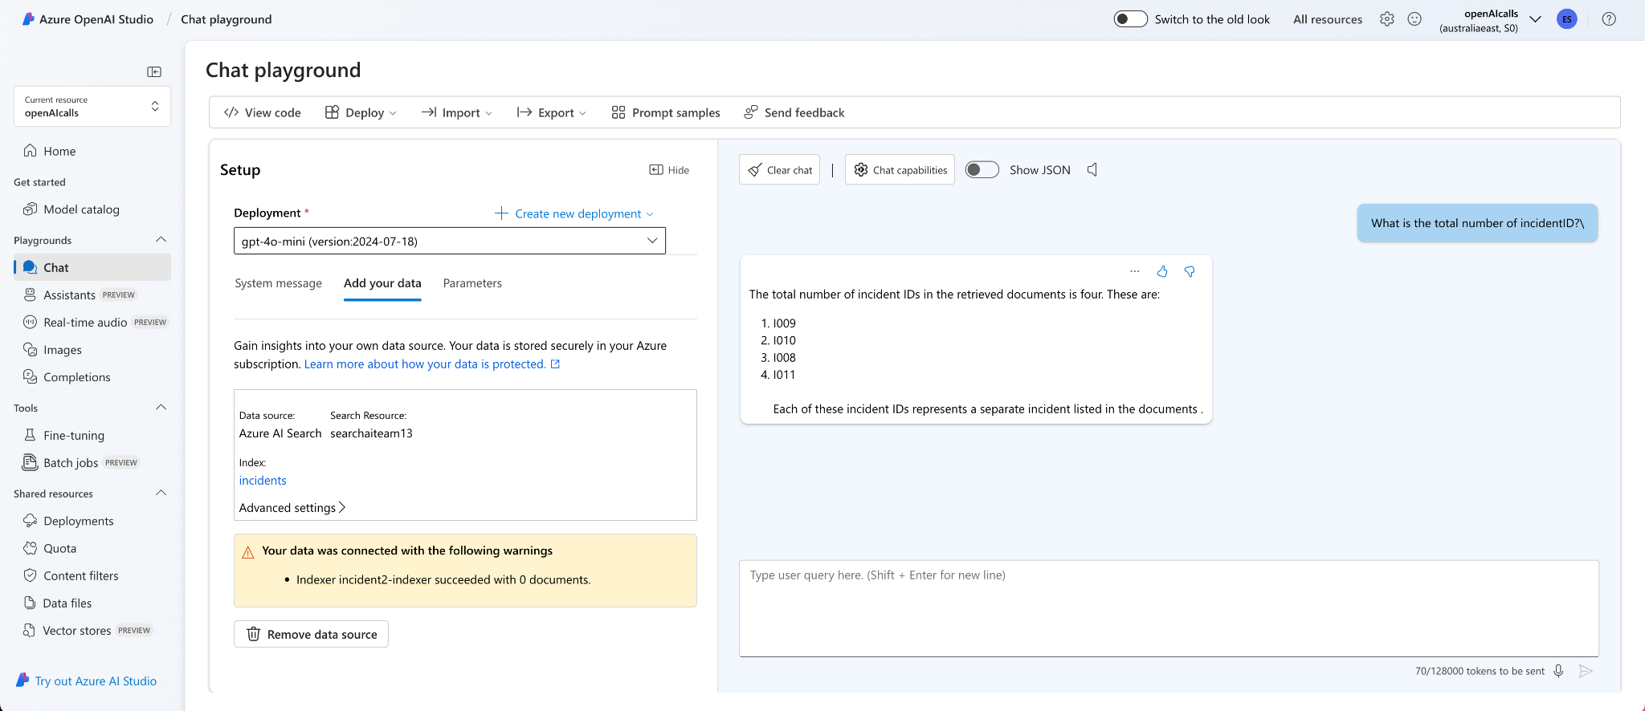
Roadblocks - AI Team
Current Roadblocks
GPT model not accessing all data
Web application is difficult to connect to model (out of scope)

Slide 16
Roadblocks - Data Team
Previous Roadblocks | Actions Taken to Overcome
Exceeded budget | Detailed cost analysis to avoid the same mistake
Current Roadblocks
Unsure about the amount of data required/needed
Notes:
Alan - Terraform/Cloud Adam - Rest

Slide 17

4
Roadblocks
‹#›

Slide 18
Upcoming Tasks - Data Team
01
02
03
Complete Deliverable 5
Start and plan Deliverable 6
Integrate AI into WebApp
04
05
Data Normalisation
Migrating scripts to Azure function
Notes:
Move onto Sprint 3 & move uncompleted backlog to Sprint 3
Build CI-CD Pipeline
Clean & Enrich Dataset 3
Find data synthetisation method 2
Deliverable 3 - Begin working & sent drafts to EY
Deliverable 3 - Work on MVP
Begin deployment of medallion architecture
Load assets into bronze layer
Azure collaboration test

Slide 19





Upcoming Tasks - AI Team
Prompt Flow Engineering
Final Presentation
Collaboration
2
4
1
3
5
Model Refinement
Reflective Report

Slide 20
Thank You

